Slide 1
IBM University Engagement Project Submission
“Exploring the Power of Agentic AI with IBM Granite and LangFlow”

Slide 2


Project Tile –
[Predicting Eligibility For NSAP Using Machine
Learning]
Domain of Project –
[ Machine Learning / Social Welfare Analytics ]
Student Name | Recent Passport Photo | Email ID | Mobile number [WhatsApp]
DURGA PRASAD ANNAMDEVULA |  | annamdevuladurgaprasad88 @gmail.com | 9618762533 9618762533

Slide 3
Problem Statement -
Problem Statement : Predicting Eligibility For NSAP Using Machine Learning.
The Challenge
The National Social Assistance Programme (NSAP) provides financial assistance to elderly persons, widows, and persons with
disabilities belonging to Below Poverty Line (BPL) households.
The current process of Data Analysis f verifying applications and assigning the correct welfare scheme is time-consuming and prone to errors. Incorrect classification can delay or prevent deserving beneficiaries from receiving assistance.
The Objective
Build a Machine Learning-based system that predicts the most appropriate NSAP scheme for an applicant using demographic and socio-economic information.
The solution should:
Applicant Classification – Classify applicants into the correct NSAP scheme.
Eligibility Prediction – Predict eligibility based on age, gender, disability status, income, and other socio-economic factors.
Data Analysis– Analyze beneficiary data and identify patterns in scheme allocation.
Automated Decision Support – Assist government agencies in reducing manual verification efforts.
Multi-Class Classification Model – Use ML algorithms such as Linear Regression, Ridge Regression for scheme prediction.
Performance Evaluation – Evaluate model Mean absolute error (MAE), MSE, RMSE.
Visualization Dashboard – Display district-wise beneficiary statistics, scheme distribution, and prediction results.

Slide 4
Technology Used
Tech Stack (Mandatory)
Use any one of the following approaches:
LangFlow + IBM watsonx.ai + Granite Models
IBM Cloud Agentic Lab with IBM Granite Models
Replicate with LangChain + RAG + IBM Granite Models
I used
IBM watsonx.ai studio

Slide 5
Proposed Solution -
Proposed Solution: Predicting Eligibility for NSAP Schemes using Machine Learning
The proposed solution is a Machine Learning-based eligibility prediction system built using Python, IBM Cloud Lite Services, and AI Kosh NSAP datasets. The system helps government agencies automatically identify the most suitable National Social Assistance Programme (NSAP) scheme for applicants based on their demographic and socio-economic information.
The solution uses historical beneficiary data from the AI Kosh dataset, including factors such as age, gender, disability status, income level, BPL status, and district information. The data is cleaned, preprocessed, and used to train a multi-class classification model.
The system consists of four key modules:
Data Processing Module : cleans and transforms applicant data for model training and prediction.
Eligibility Prediction Module: uses Machine Learning algorithms such as Random Forest, Decision Tree, or XGBoost to predict the most appropriate NSAP scheme.
Beneficiary Analysis Module: analyzes trends and patterns in beneficiary data across different districts and categories.
Visualization Dashboard Module: displays scheme-wise statistics, district-wise beneficiary distribution, prediction results, and model performance metrics.
The solution includes a user-friendly dashboard built using Streamlit that allows users to enter applicant details and instantly
receive eligibility predictions.
IBM Cloud Lite services are used for model deployment, data storage, and application hosting. The trained model provides fast and accurate predictions, reducing manual effort and improving transparency in welfare scheme allocation.
Overall, the solution delivers an intelligent decision-support system that helps ensure eligible citizens receive the correct NSAP
benefits efficiently and accurately.

Slide 6
Machine Learning component Used -
Data Input Component
Collects NSAP beneficiary data from the dataset.
Inputs include District, State, Scheme Code, Aadhaar Status, Beneficiary Count, OBC, SC, and ST details.
2) Data Preprocessing Component
Handles missing values and duplicate records.
Converts categorical data (District, State, Scheme Code) into numerical format.
Normalizes and prepares data for model training.
3) Feature Selection Component
Selects important attributes affecting eligibility prediction:
Scheme Code
Aadhaar Availability
Beneficiary Statistics
District Name State Name
Social Category (OBC/SC/ST)
4) Machine Learning Model Component
Linear Regression Ridge Regression
Trains the model to predict NSAP scheme eligibility and beneficiary patterns.
IBM watsonx.ai AutoAI was used to automatically generate, optimize, and compare multiple machine learning pipelines using the NSAP pension dataset. Based on the characteristics of the dataset, AutoAI selected Ridge Regression and Linear Regression as the most suitable algorithms for model development.
The generated pipelines were enhanced through Feature Engineering (FE) and Hyperparameter Optimization (HPO) to improve prediction performance. The models were trained and evaluated using cross-validation, and their performance was measured using Root Mean Squared Error (RMSE).
Among all the generated pipelines, the optimized Ridge Regression model achieved the best performance with the lowest RMSE score. Therefore, the Ridge Regression pipeline was selected as the final model for prediction and deployment in the proposed system.

Slide 7
5) Model Evaluation Component
Splits data into Training and Testing datasets.
The models generated by IBM watsonx.ai AutoAI were evaluated using Cross-Validation and RMSE.
AutoAI applied Feature Engineering (FE) and Hyperparameter Optimization (HPO) to improve performance.
Evaluates model performance using
cross validation RMSE Feature Engineering HPO – Hyper parameter optimization ridge regression
Prediction Component
predicts whether an applicant is eligible for NSAP scheme based on input details.
Uses the trained regression model to predict beneficiary counts based on input features.
Processes the selected attributes and generates numerical prediction values.
Produces beneficiary predictions such as 15183.41, 15168.63, and 15181.57.
Displays the prediction results in table and graph formats.
Supports analysis of beneficiary patterns and scheme planning.
7. Output Component
Displays the final prediction results generated by the Machine Learning model.
Presents predicted beneficiary counts in a tabular format.
Visualizes prediction distribution using graphs and charts.
Enables users to analyze and interpret the predicted values easily.
Provides outputs that support decision-making and beneficiary planning.
8. Data Storage Component
Stores dataset, trained model and prediction results for future use.

Slide 8
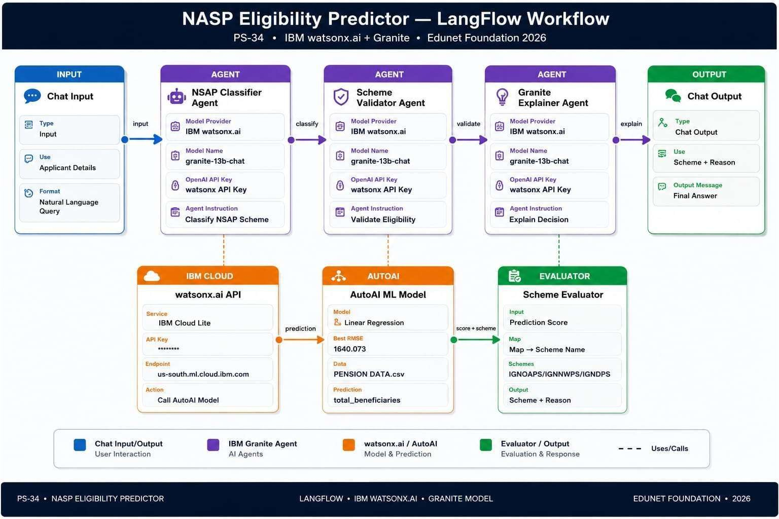
Langflow workflow -

Slide 9
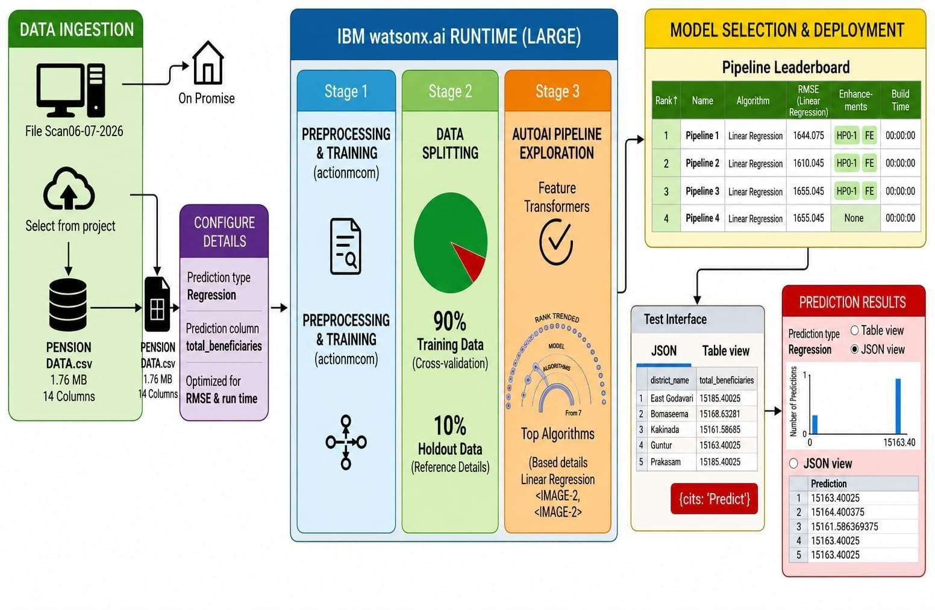
Architecture blueprint

Slide 10
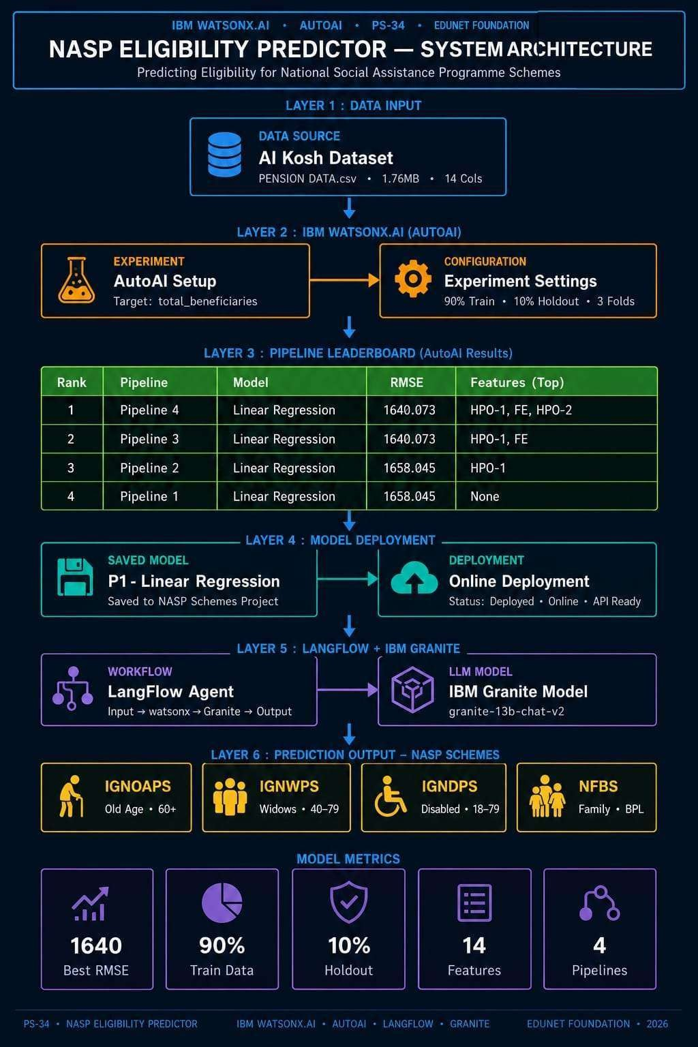

Slide 11
Technology Used
Langflow platform - Used for designing and orchestrating AI workflows visually.
IBM Grainte model - Used for natural language understanding and intelligent responses.
IBM Cloud – Provides secure and scalable infrastructure for deployment.
RAG– Provides secure and scalable infrastructure for deployment..
IBM Watsonx.ai- Provides secure and scalable infrastructure for deployment.
Vector Database (FAISS/Chroma) – Stores and retrieves scheme documents efficiently.

Slide 12
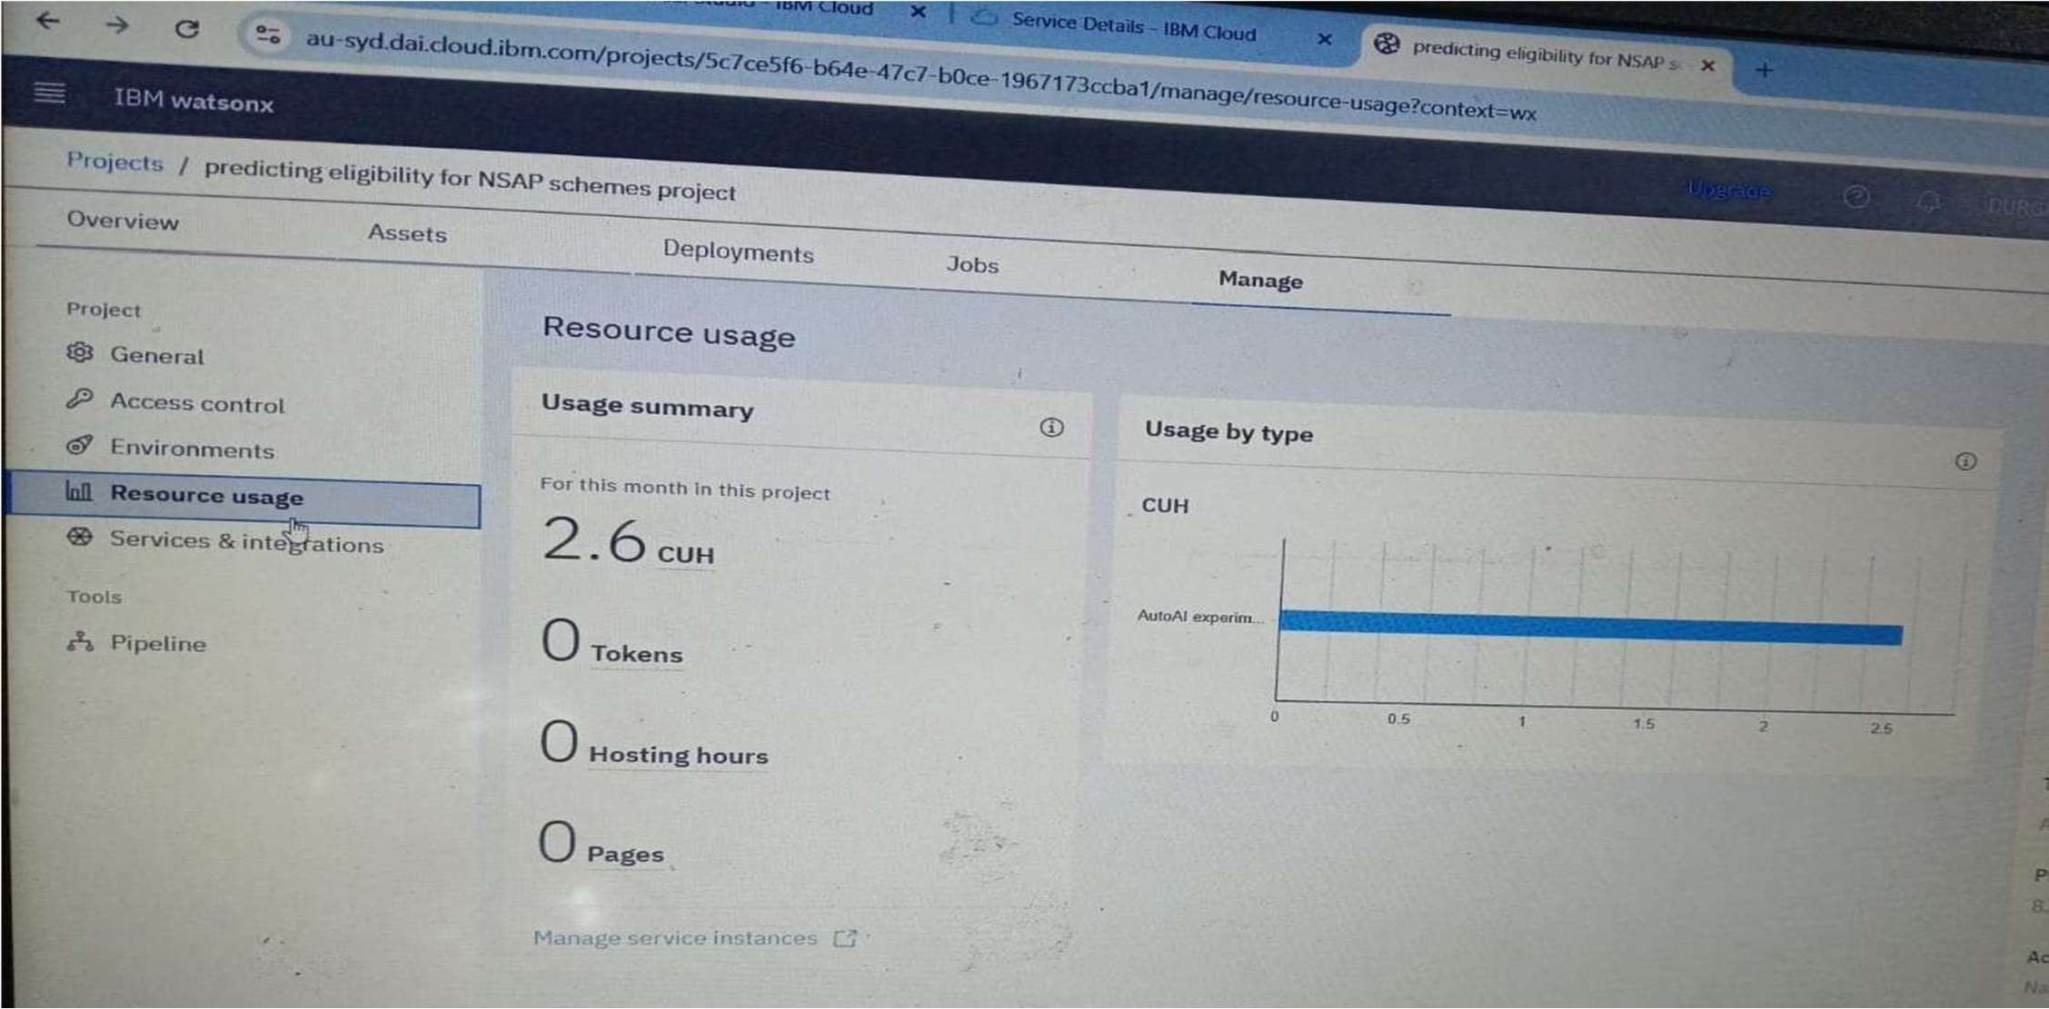
Token usage

Slide 13
Novelty and Uniqueness
The proposed NSAP Eligibility Prediction System combines Machine Learning, RAG, and AI-powered assistance to simplify the identification of eligible beneficiaries for government welfare schemes.
Automated Eligibility Prediction – Uses machine learning models to analyze applicant data and predict eligibility accurately..
Data driven Decision Making– Reduces manual screening and improves consistency in beneficiary selection.
RAG-Based Information Retrieval – Retrieves the latest NSAP guidelines and eligibility criteria before generating responses.
Personalized Scheme Recommendation – Suggests the most suitable NSAP scheme based on age, income, disability status, and other applicant details.
Real-Time Query Assistance – Provides instant answers to user questions regarding scheme benefits, documents required, and application procedures.
Transparency & Fairness – Minimizes human bias by applying uniform eligibility criteria across applicants.
Scalable & Government Ready – Built using IBM watsonx.ai, IBM Granite, and Langflow, making it suitable for large-scale deployment.
User-Friendly Interface – Enables citizens and officials to check eligibility quickly and efficiently– Enables citizens and officials to check eligibility quickly and efficiently

Slide 14
Git Hub Link
Please create public github repository (Enable Add README button while creating repository)
with format –
Please test and Paste the working Github URL –
https://github.com/Annamdevula1/PREDICTING-THE-ELIGIBILITY-FOR-NSAP-USING-
ML.git
·
·
·

Slide 15
Future Scope
Integration with Government Databases
The system can be integrated with government databases such as Aadhaar, ration card, and socio-economic records to automatically verify applicant details and improve eligibility prediction accuracy. This will reduce manual
verification efforts and help identify eligible beneficiaries more efficiently.
AI-Powered Recommendation & Real-Time Eligibility Checking
Future versions can use advanced Machine Learning and AI models to provide real-time eligibility predictions for multiple welfare schemes. The system can also recommend the most suitable NSAP scheme (Old Age Pension,
·Widow Pension, Disability Pension, etc.) based on a citizen's profile and eligibility criteria.
Mobile Application Multilingual Support
A mobile application with multilingual support can make the system accessible to rural and urban users across India.
Citizens can check their eligibility, submit applications, and track application status in their preferred language.
Fraud Detection and Beneficiary Verification
The system· can incorporate fraud detection mechanisms to identify duplicate or ineligible beneficiaries, ensuring that welfare benefits reach only eligible citizens and improving transparency in scheme implementation.

Slide 16
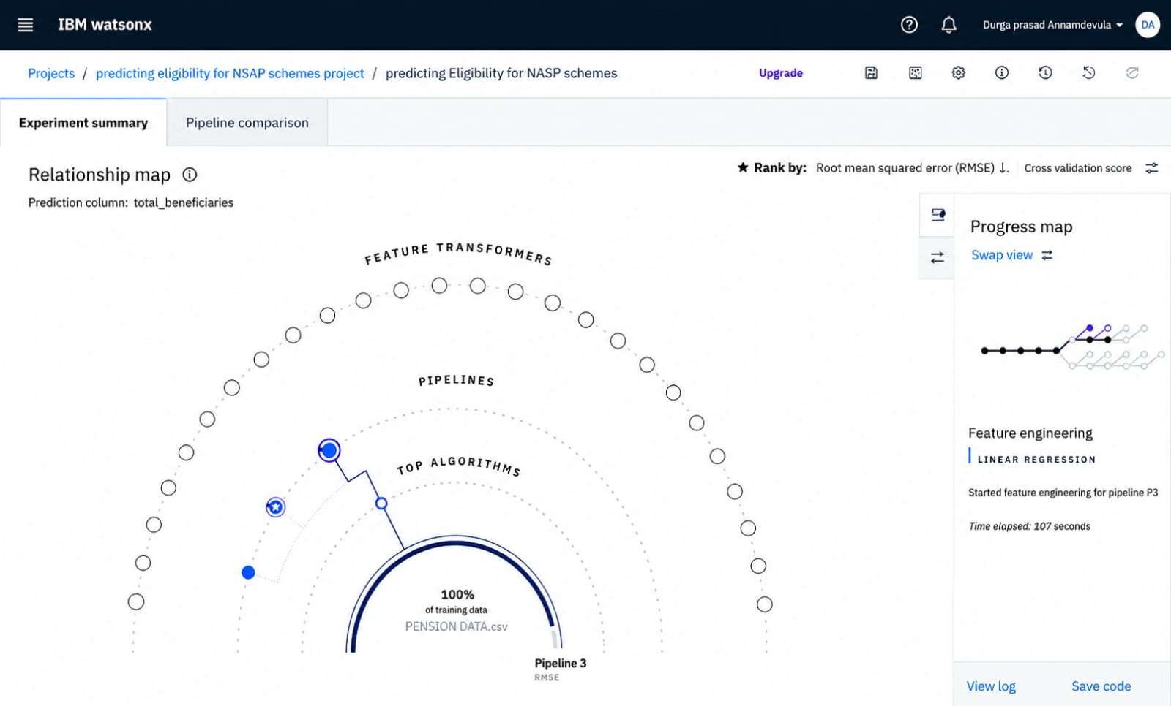
SCREEN SHOTS

Slide 17
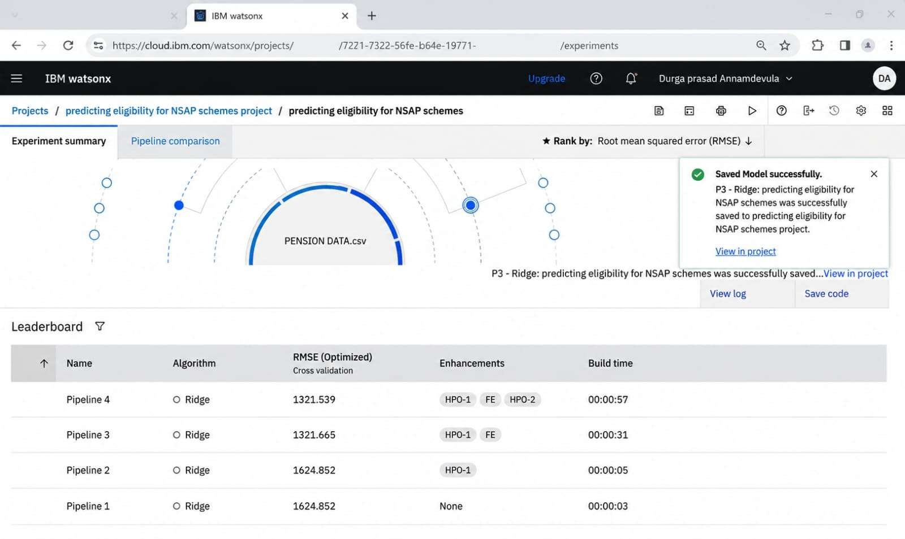




IBM watsonx
httpc //cloud.ibm.com/watsonx/prnjects/
/experiment
DA
Projects / predicting eligibility for NSAP schemes project / predicting etigit›itity for NSAP schemes
Experiment summary Pipeline comparison
Rank by: Root mean squared error tRN5E) 4
Savnd fflodel successfully.
P3 - Ridge: predict ng eligibility for NSAP schemes was successfully saved to predicting eligibility for NSAP schemes project.
View in project
P3 - Ridge: predicting eligibility for NSAP schemes was successfully saved...View in project
View log Save code
Leaderboard 9
Name
Pipeline 4
00:00 57
Pipeline 3
00:001
Pipeline 2
00:00:OS
Pipeline 1

Slide 18
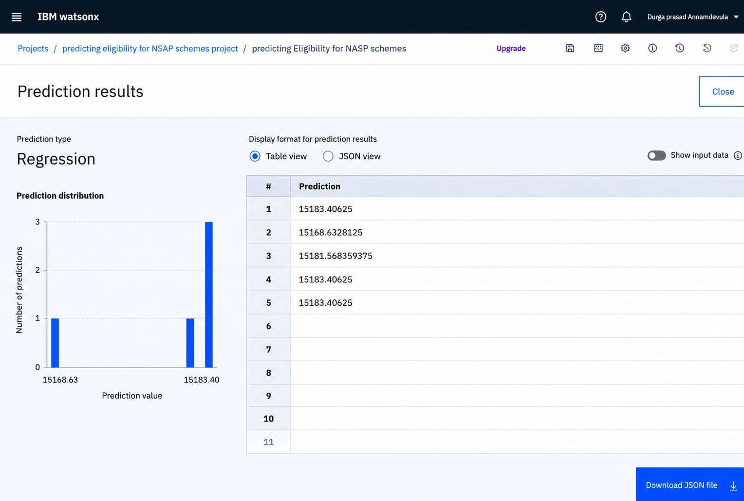



upgrade
Prediction type
Regression
Display format for prediction results Table view I S D N view
Show input oata
15183.40625
15181.568359375
1 S3.40G25
15168.63
15i83.40
Prediction value
Projects / preclicting eligibility fnr NSAP schemes project / preclicting Etigihility for NASP schemes

Slide 19
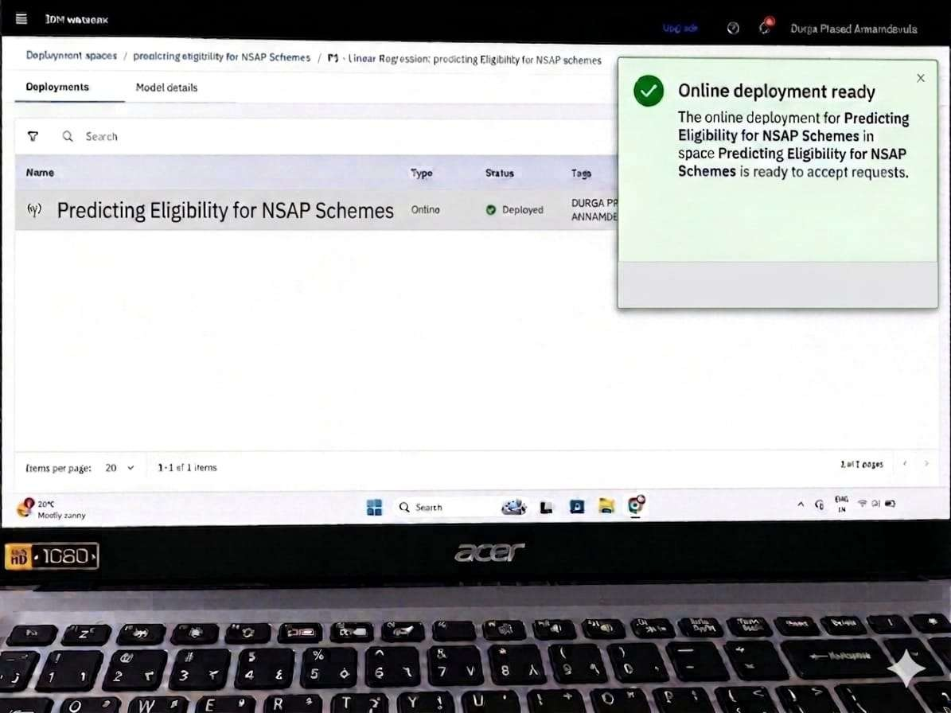

Slide 20


